Slide 1
The MAZE
Jiajia Ding

Slide 2
abstract
At CS455 Algorithm class, Breadth-First Traversal algorithm was introduced to solve the Maze. This slides was created to demonstrate what we have learnt from the class.

Slide 3
acknowledgement
I would like to thank Professor Henry Chang for sharing with me his time, efforts, and knowledge in the computer science industry.

Slide 4
Table of content
Abstract
Acknowledgement
Introduction
Breadth-First Traversal
Test
Conclusion
Appendix

Slide 5
Introduction
Breadth-First Traversal
When solving the maze, Breadth-First Traversal approach can be taken.

Slide 6
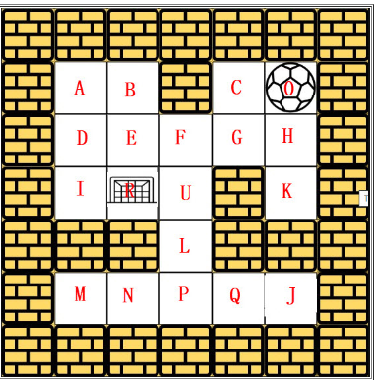
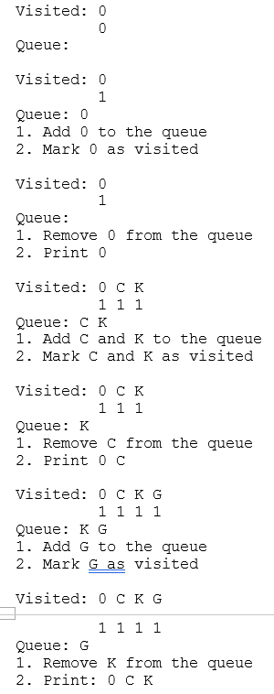
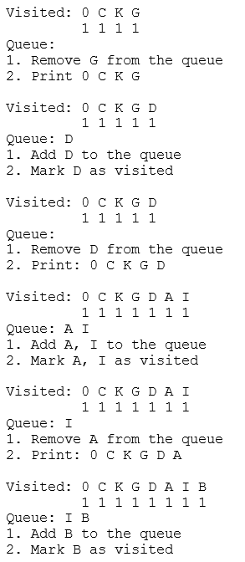
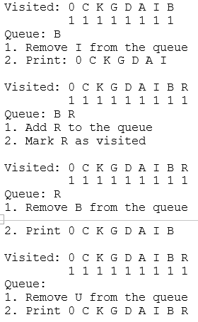
The Maze
Right, Left, Up, Down
The ball can go through the empty spaces by rolling right, left, up, down, but it won't stop rolling until hitting a wall. When the ball stops, it could choose the next direction.

Slide 7
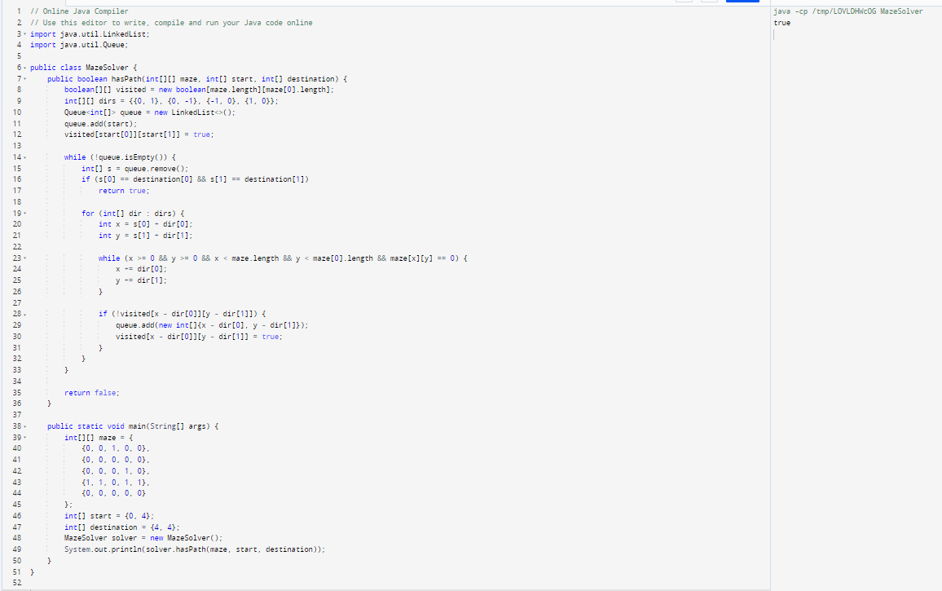
Test
An exemplar code with one test case created by ChatGPT is attached

Slide 8
conclusion
The maze can be solved using both Depth-First Traversal and Breadth-First Traversal. Page 6 is the route the ball will go using Breadth-Frist Traversal.

Slide 9
Appendix
https://hc.labnet.sfbu.edu/~henry/npu/classes/algorithm/graph_alg/slide/maze.html#Approach%205:%20Wheeled%20robots%20move%20in%20a%20Hotel:%20BFS
https://hc.labnet.sfbu.edu/~henry/npu/classes/algorithm/graph_alg/slide/exercise_graph_alg.html#490_bft

Slide 10
THANK YOU

